Slide 1
Live Project 1
Retail Data Analysis using Pig and Hive

Slide 2
Retail Transactions
Retail stores daily generate millions of transactions logs.
Analyzing these logs would generate beautiful insights and improve business.
Storing these logs on traditional databases would be costly and scalability will be a big challenge.

Slide 3
Volume of transactions
Stores like walmart are spread across different locations.
Daily millions of customers visit these stores and generate billions of logs.
This billions of logs contribute to huge volume of data.

Slide 4
Velocity of transactions
In peak hours, 1000’s of transactions will happen in any given second.
1000’s of trasactions/sec across all stores contribute to high velocity.

Slide 5
Variety of transactions
The most widely known varities of data generated by transactions:
Json Format
Xml Format
Csv Format

Slide 6
Its Bigggg Data
Having Huge Volume, High velocity and variety will make this data Big Data.
Challenges:
Storage
Scalability
Processing
Sharing

Slide 7
Goal
Process these logs over night as a batch to understand:
Demand of a given product.
Trend and seasonality of sales.
Understand performance of chain.
Loyal Customer identification.

Slide 8
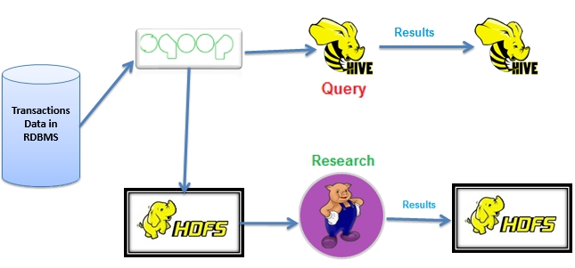
Solution

Slide 9
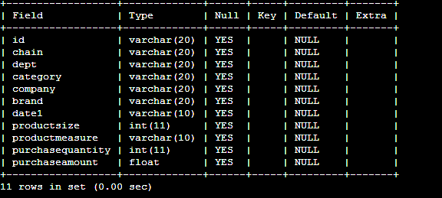
Transactions dataset

Slide 10
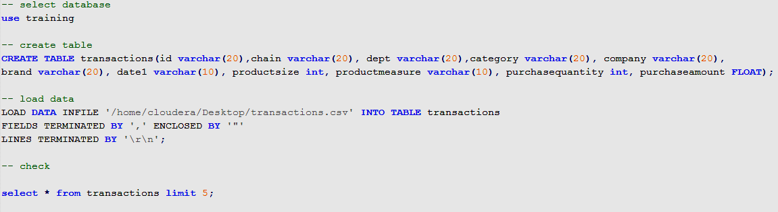
Load data into MySQL
Notes:
-- select database
use training
-- create table
CREATE TABLE transactions(id varchar(20),chain varchar(20), dept varchar(20),category varchar(20), company varchar(20),
brand varchar(20), date1 varchar(10), productsize int, productmeasure varchar(10), purchasequantity int, purchaseamount FLOAT);
-- load data
LOAD DATA INFILE '/home/cloudera/Desktop/transactions.csv' INTO TABLE transactions
FIELDS TERMINATED BY ',' ENCLOSED BY '"'
LINES TERMINATED BY '\r\n';

Slide 11

Retail Data Analysis with Pig
describe
illustrate
explain
Use the above commands for better understanding of schema and data flow.

Slide 12

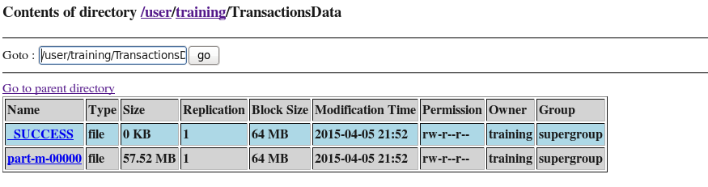
SQOOP data into HDFS

Slide 13
Load data into pig
transactions = LOAD 'TransactionsData/part-m-00000' USING PigStorage(',') as (id:chararray,chain:chararray,dept:chararray,category:chararray,company:chararray,brand:chararray,date:chararray, productsize:float, productmeasure:chararray, purchasequantity:int, purchaseamount:float);

Slide 14
Top 10 customers
custGroup = GROUP transactions BY id; --grouping
custSpendings = FOREACH custGroup GENERATE group, SUM(transactions.purchaseamount) as spendings; --sum operation
custSpendingsSort = ORDER custSpendings BY spendings desc;
top10Cust = LIMIT custSpendingsSort 10;
DUMP top10Cust;
STORE top10Cust INTO ‘top10Cust’

Slide 15
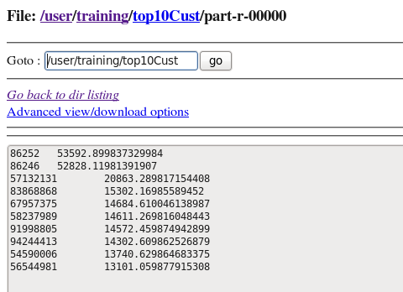
Snap shot of output

Slide 16
Chain wise sales
chainGroup = GROUP transactions BY chain;
chainSales = FOREACH chainGroup GENERATE group, SUM(transactions.purchasequantity) as totalQuantity, SUM(transactions.purchaseamount) as totalSales;
dump chainSales;
STORE chainSales INTO 'chainSales‘;

Slide 17
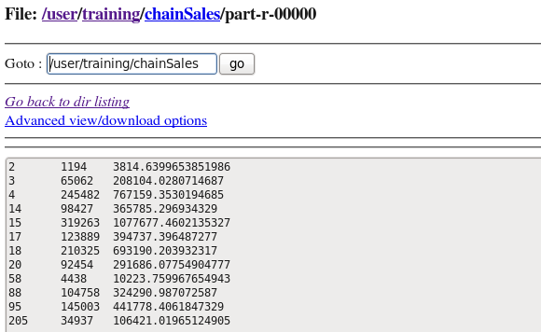
Snapshot of output

Slide 18
Each chain, top 10 customers
chainGroupCust = GROUP transactions BY (chain,id);
chainGroupCustSpedings1 = FOREACH chainGroupCust GENERATE group, SUM(transactions.purchaseamount) as spendings;
chainGroupCustSpendings2= FOREACH chainGroupCustSpedings1 generate group.chain as chain,group.id as id, spendings;
chainGroupCustSpendings3= GROUP chainGroupCustSpendings2 BY chain;
chainTop10Cust = FOREACH chainGroupCustSpendings3{ chainGroupCustSpedingsSort = ORDER chainGroupCustSpendings2 BY spendings DESC;
top10Cust = LIMIT chainGroupCustSpedingsSort 10;
GENERATE top10Cust;
}
chainTop10Cust = FOREACH chainTop10Cust GENERATE FLATTEN(top10Cust);
STORE chainTop10Cust INTO ‘chainTop10Cust ’

Slide 19
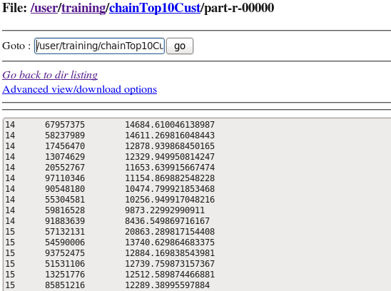
Snapshot of output
This operation cannot be done using hive queries

Slide 20
Each customer most bought brand
CustBrandGroup = GROUP transactions BY (id,brand);
CustBrandQuantity = FOREACH CustBrandGroup GENERATE group, SUM(transactions.purchasequantity) as sales;
CustBrandQuantity = FOREACH CustBrandQuantity GENERATE group.brand as brand, group.id as id, sales;
CustBrandQuantityGroup = GROUP CustBrandQuantity BY brand;
custTop5Brands = FOREACH CustBrandQuantityGroup{ CustBrandQuantityGroupSort = ORDER CustBrandQuantity BY sales DESC; top5Brand = LIMIT CustBrandQuantityGroupSort 5; GENERATE top5Brand;}
custTop5Brands = FOREACH custTop5Brands GENERATE FLATTEN(top5Brand);
STORE custTop5Brands INTO 'custTopFiveBrands';

Slide 21
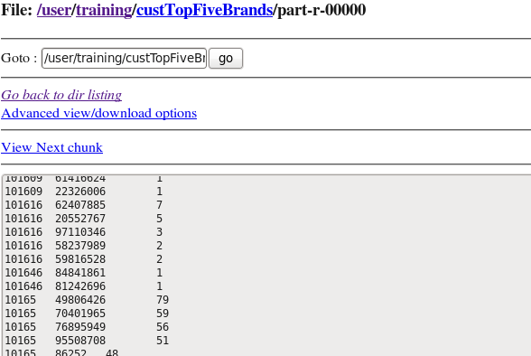
Snapshot of output
This operation cannot be done using hive queries

Slide 22
Top 10 brands
brandGroup = GROUP transactions BY brand;
brandPurchase = FOREACH brandGroup GENERATE group, SUM(transactions.purchaseamount) as purchase;
brandPurchaseSort = ORDER brandPurchase BY purchase desc;
top10Brands = LIMIT brandPurchaseSort 10;
STORE top10Brands INTO 'top10Brands';

Slide 23
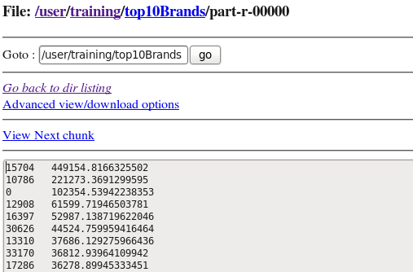
Snapshot of output

Slide 24
top 10 companies
companyGroup = GROUP transactions BY company;
companyPurchase = FOREACH companyGroup GENERATE group, SUM(transactions.purchaseamount) as purchase;
companyPurchaseSort = ORDER companyPurchase BY purchase desc;
top10Companies = LIMIT companyPurchaseSort 10;
STORE top10Companies INTO 'top10Companies';

Slide 25
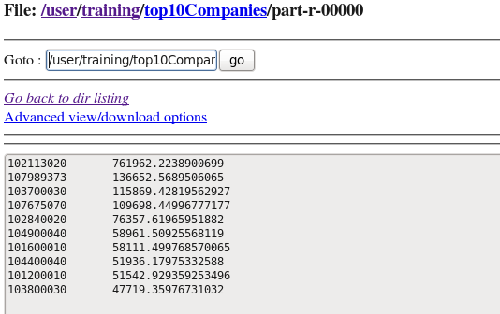
Snapshot of output

Slide 26
Chain Year Monthly Sales
chainYearMonSales = FOREACH transactions GENERATE chain,STRSPLIT(date,'/',3),purchaseamount as sales;
chainYearMonSales = FOREACH chainYearMonSales GENERATE chain, $1.$0 as month, $1.$2 as year, sales;
chainYearMonSalesGroup = GROUP chainYearMonSales by (chain,year,month);
chainYearMonGroupSales = FOREACH chainYearMonSalesGroup GENERATE group, SUM(chainYearMonSales.sales) as totalsales;
chainYearMonGroupSales = FOREACH chainYearMonGroupSales GENERATE group.chain as chain, group.year as year, group.month as month, totalsales;
STORE chainYearMonGroupSales INTO 'chainYearMonGroupSales';

Slide 27
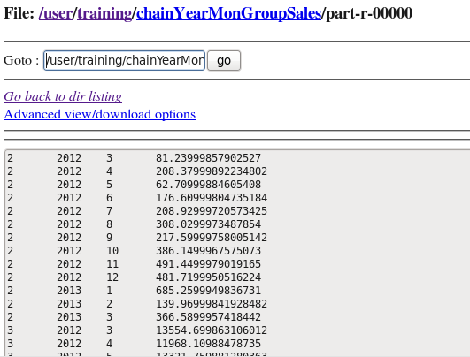
Snapshot of output

Slide 28

Retail Data Analysis with Hive

Slide 29
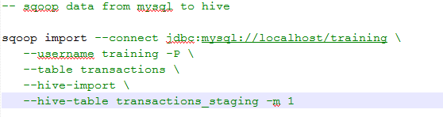
Sqoop data into hive
Notes:
-- sqoop data from mysql to hive
sqoop import --connect jdbc:mysql://localhost/training \
--username training -P \
--table transactions \
--hive-import \
--hive-table transactions_staging -m 1

Slide 30
Partioning and bucketing
Partitioning and bucketing in hive will let you do faster querying.
For dynamic partitioning, load the data in to staging table which is already done.
Now create a production table, and insert data.

Slide 31

Open hive and set below properties
Notes:
-- Partitioning and bucketing
set hive.enforce.bucketing = true;
SET hive.exec.dynamic.partition = true;
SET hive.exec.dynamic.partition.mode = nonstrict;

Slide 32
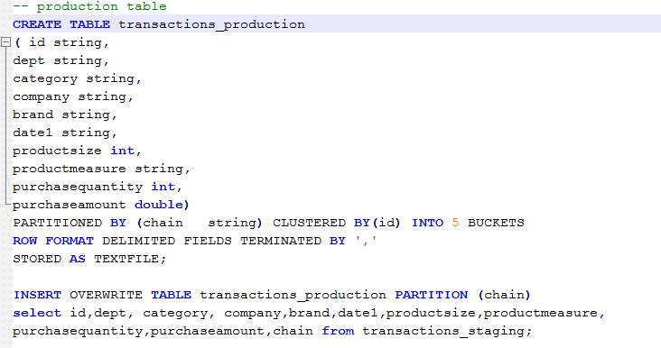
Create production table and load data
Notes:
-- production table
CREATE TABLE transactions_production
( id string,
dept string,
category string,
company string,
brand string,
date1 string,
productsize int,
productmeasure string,
purchasequantity int,
purchaseamount double)
PARTITIONED BY (chain string) CLUSTERED BY(id) INTO 5 BUCKETS
ROW FORMAT DELIMITED FIELDS TERMINATED BY ','
STORED AS TEXTFILE;
INSERT OVERWRITE TABLE transactions_production PARTITION (chain)
select id,dept, category, company,brand,date1,productsize,productmeasure,
purchasequantity,purchaseamount,chain from transactions_staging;

Slide 33
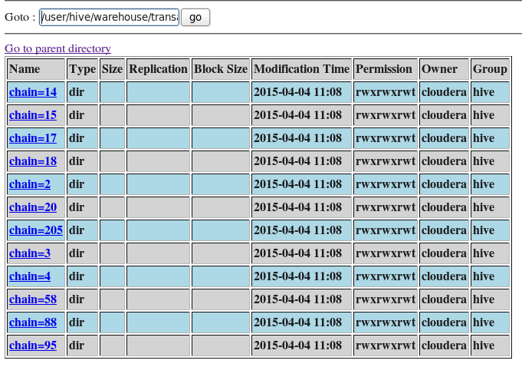
Partitioning snapshot

Slide 34
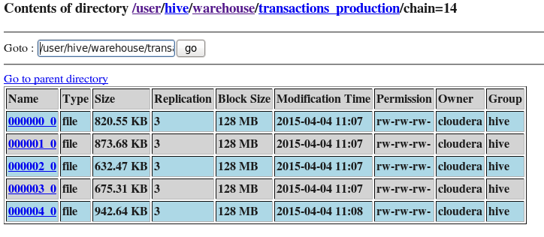
Bucketing snapshot in chain=14

Slide 35
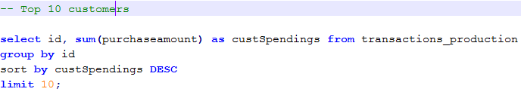
Top 10 customers
Notes:
select id, sum(purchaseamount) as custSpendings from transactions_production
group by id
sort by custSpendings DESC
limit 10;

Slide 36
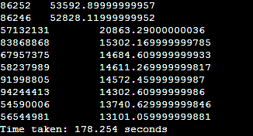
Snapshot of output

Slide 37
Chain wise sales
Notes:
select chain, sum(purchaseamount), sum(purchasequantity) from transactions_production
group by chain;

Slide 38
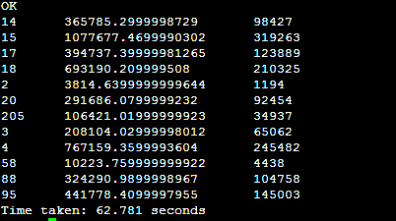
Snapshot of output

Slide 39
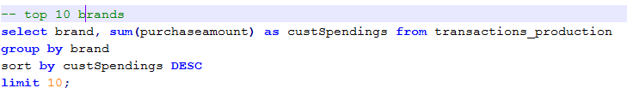
Top 10 brands
Notes:
-- top 10 brands
select brand, sum(purchaseamount) as custSpendings from transactions_production
group by brand
sort by custSpendings DESC
limit 10;

Slide 40
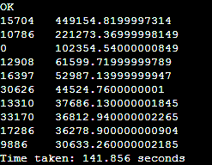
Snapshot of output

Slide 41
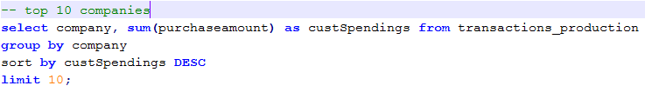
Top 10 companies
Notes:
-- top 10 companies
select company, sum(purchaseamount) as custSpendings from transactions_production
group by company
sort by custSpendings DESC
limit 10;

Slide 42
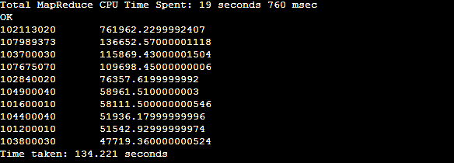
Snapshot of output

Slide 43

Chain Year Monthly Sales
Notes:
-- Chain Year Monthly Sales
select chain, split(date1,'/')[2] as year1, split(date1,'/')[0] as month1,
sum(purchaseamount) as totalsales from transactions_production
group by chain,split(date1,'/')[0],split(date1,'/')[2];

Slide 44
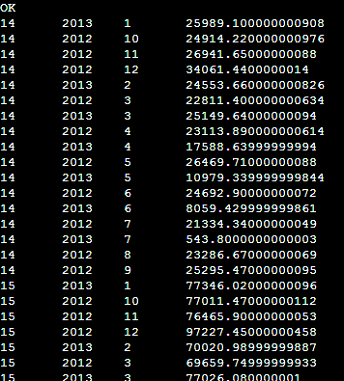
Snapshot of output

Slide 45
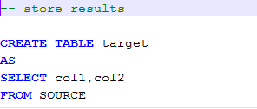
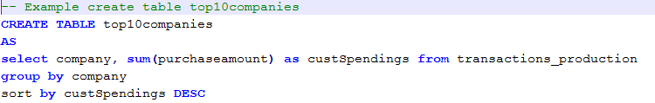
Storing results
To store results
Notes:
-- Example create table top10companies
CREATE TABLE top10companies
AS
select company, sum(purchaseamount) as custSpendings from transactions_production
group by company
sort by custSpendings DESC

